Slide 1






GMHST
Introducing the Greenwich Mental Health in Schools Team

Slide 2


Aims
  To introduce the Greenwich MHST service.
  To understand what is Social, Emotional & Mental Health and Wellbeing.
  To explain how to seek support and Greenwich MHST referral process.

Slide 3



Green Paper
One in six children experience a mental health problem. Half of lifetime cases of mental health problems begin by the age of 14.
MHST came about in response to the Governments Green Paper.
  MHSTs will provide evidence based interventions to support those with mild to moderate needs.
  MHSTs will support the promotion of good mental health, wellbeing and whole school approaches.
Notes:
What is Green Paper?
This green paper is about what the government want to do to help children and young people with their mental health. A green paper is a document where the government states what it wants to do, so that people can tell the government what they think.
Summary: The green paper sets out the ambition that children and young people who need help for their mental health are able to get it when they need it.
The green paper focuses on earlier intervention and prevention, especially in and linked to schools and colleges.
Implications:
what does that mean for school attainment, future perspective, health and life expectancy (ie risk of comorbidity and premature death) and wider impact on family and society in terms of loss income due to care, treatment, benefit, loss of revenue to the economy.

Slide 4

Who are the GMHST Team?
  Education Mental Health Practitioners (EMHPs) – EMHPs deliver evidence-based interventions for low and moderate needs within an educational setting.
  Senior Practitioners deliver a variety of evidence-based interventions, triage new referrals and support the whole school approach
  Lead practitioners– Support the whole school approach and referral onto specialist mental health services when appropriate for individuals.
  Team Manager & Administrative Support.
.
Notes:
Staff support Expand – (Staff wellbeing , promoting positive wellbeing in Staff, CYP and families )

Slide 5


Did you know..?
  One in six children experienced a mental health problem in 2021.
Notes:
Implications:
what does that mean for school attainment, future perspective, health and life expectancy (ie risk of comorbidity and premature death) and wider impact on family and society in terms of loss income due to care, treatment, benefit, loss of revenue to the economy.

Slide 6
GMHST- What we do
  Help your child to understand their feelings.
  Help your child to think about ways to cope with their feelings.
  Talk with parents/carers to think about how to help your child when they are finding things difficult.
  Ensure children and young people are able to access appropriate support all year round (not just term time).
  Support schools in developing their whole school approach to mental health.

Slide 7


GMHST
We work across the school to help with your emotional wellbeing.
What will we do?
  Assemblies
  Group Workshops
  1 to 1 sessions
  Staff, CYP and Family Support
We currently support 50% of Greenwich schools!

Slide 8

What is Emotional Wellbeing & Mental Health?
Notes:
What is Mental Health/Wellbeing?
Ask the cohort to put their hands up to define the definition
Mental Wellbeing: is how we respond to life’s ups and downs. It includes how a person thinks, handles emotion (emotional wellness), and acts.

Slide 9









Emotional Wellbeing
How
We feel
Self-
Esteem
Participation
How
We Think
Physical
Health
Hobbies
How
We Act
Environments
Relationships
Notes:
What is Emotional Wellbeing?
Emotional well-being refers to how well people are able to accept and manage their emotions and cope with challenges throughout life. *Emotional well-being can affect how well someone can function day to day or how they are able to deal with change or uncertainty.

Slide 10




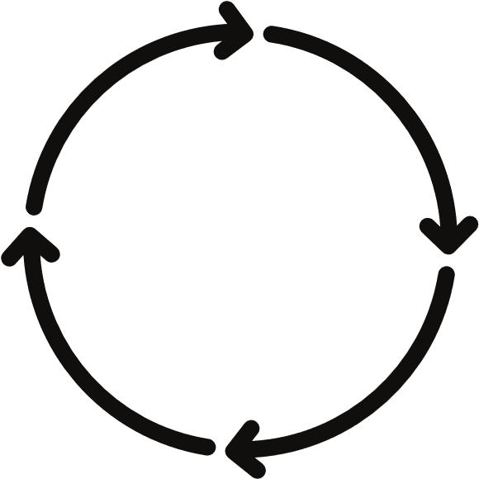



Anxiety Cycle
Triggers
Look out the window and see snow
Thoughts
“A day off school”
“Snowman”
Behaviours
Make a snowman
Get dressed and wake parents/carers
Feelings/Emotions Happy
Excited
Bodily Sensation
Energy
Excitement
Heart racing
Notes:
Think about a time when you have felt worried -How does it feel in your body?

Slide 11



Feeling Anxious or Worried
Worrying Thoughts:
  Putting hand up in class
  Going To Secondary School
  Exams
  Friendship
Feelings & Body Sensations:
  Butterflies
  Heart Beating
  Sweaty Hands
Behaviours:
  Not wanting to go to school
  Tired
  Distracted
  Getting annoyed with people

Slide 12

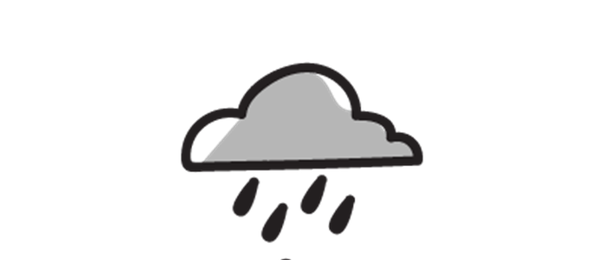

Emotional Dysregulation
Unhelpful Thoughts
  ‘It’s my fault’
  ‘I’m never going to feel better’
  ‘Nobody likes me’
Feelings & Body Sensations:
  Tired
  Headaches
  Tummy aches
Behaviours:
  Crying
  Tired or Fatigue
  Isolation
  Sleep Difficulties
Notes:
Emotional dysregulation refers to the inability of a person to control or regulate their emotional responses to provocative stimuli. Impacts on unhelpful thoughts , feelings & body sensations, mood changes and behaviours.

Slide 13
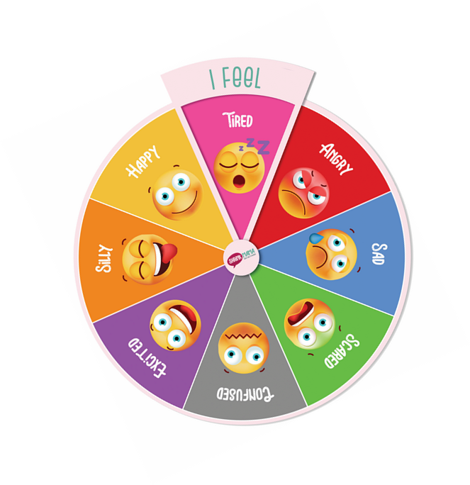
Behaviours linked to Mood
  Not listening to rules set by school or parents
  Being unkind to others
  Shouting
  Not going in to school
  Physically hurting someone out of anger
  Swearing
  Throwing things
  Crying
  Wanting to run away
  Not wanting to leave parent/carer
  Not being able to sleep
  Not feeling hungry or eating too much
  Being forgetful
  Being very quiet
Notes:
Explore behaviours i.e increased appetite, sleep problems explain sleeping less/more
Explain T F B Cycle – change behaviours to motivate and enhance mood = Behaviour Activation

Slide 14


So How Can We Help?
One to one Interventions: therapy sessions for Child Anxiety with children or parents/carers and Challenging Behaviour with Parents/Carers remotely and in primary school settings using CBT based principles.
.
Psychoeducational Workshops with the whole class and/or targeted groups/individuals.
Workshops and Training to staff and parents covering a wide range of wellbeing topics.

Slide 15
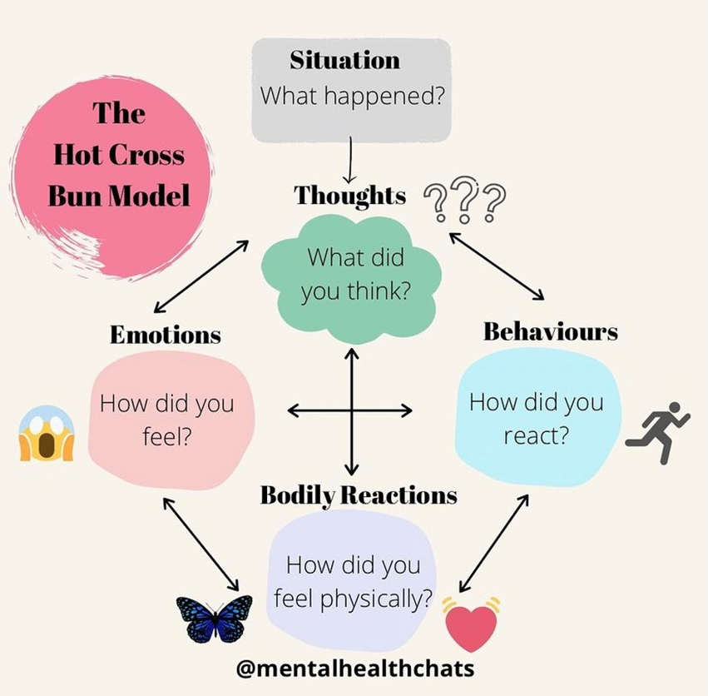
Hot Cross Bun Model
Notes:
This is what we call the Hot Cross Bun Model / ‘Vicious Cycle’ - it shows how our Thoughts, Feelings, Physical Sensations and Behaviours are linked.

Slide 16

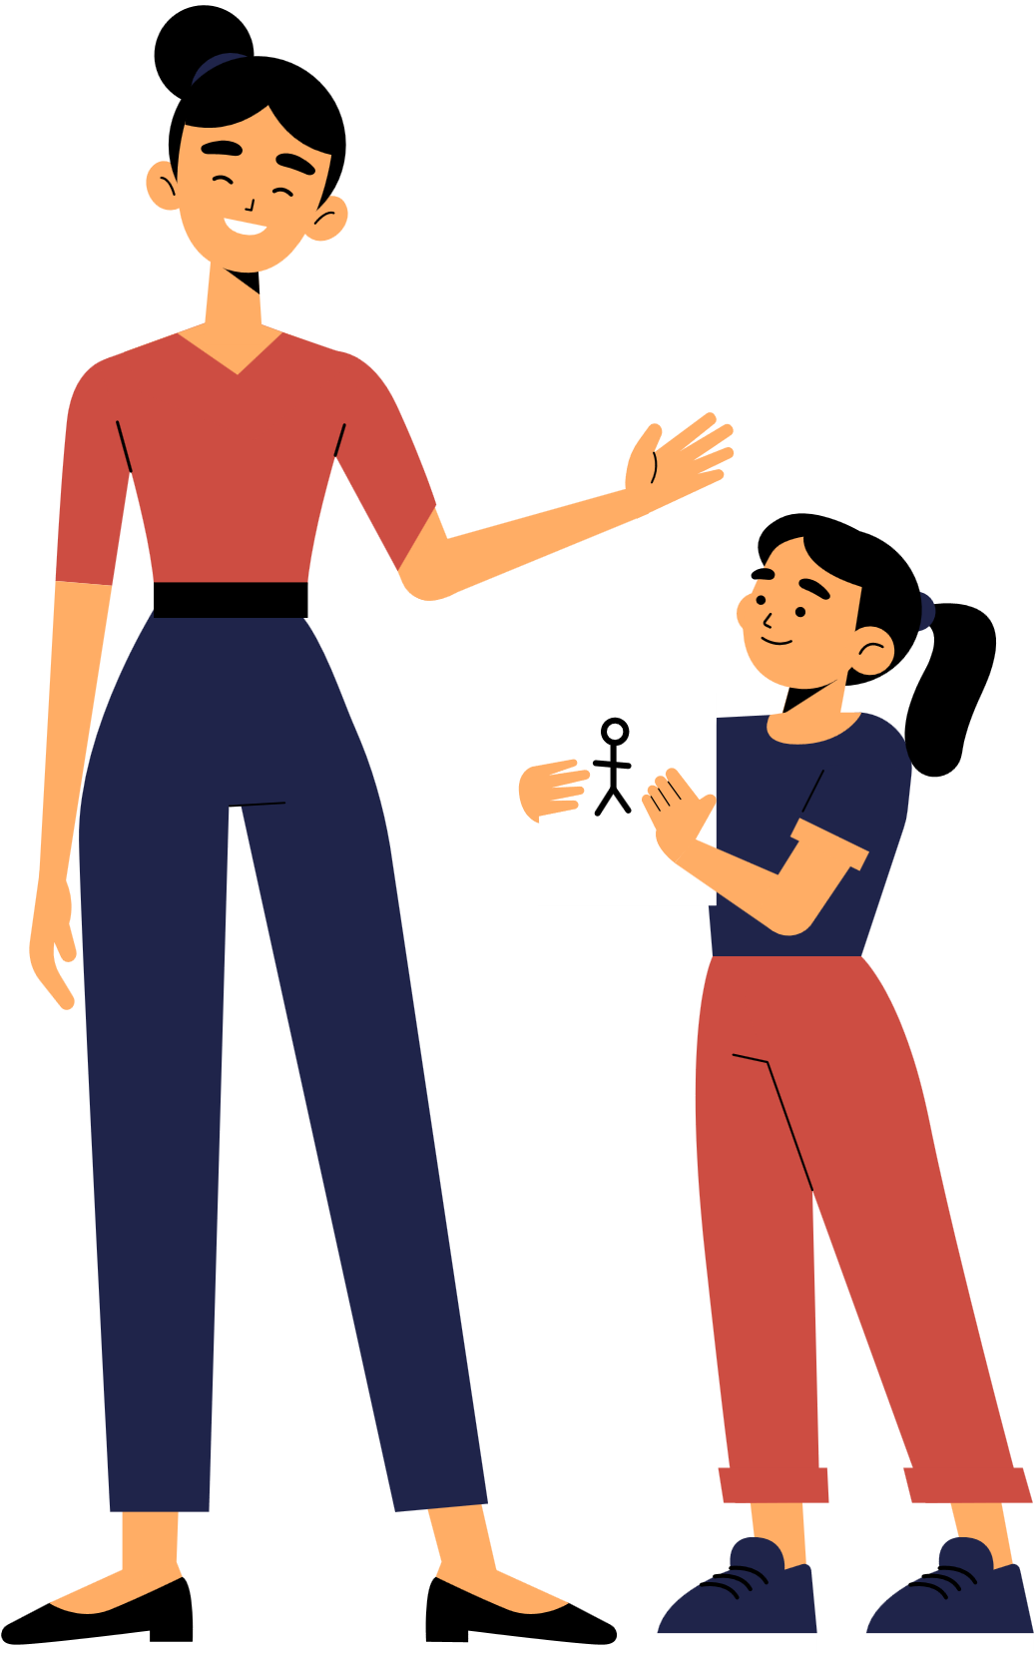
Referral Pathway
How to refer?
  Speak to a teacher if you would like more information or wellbeing support.
  Or alternatively contact GMHST directly by email: oxl-tr.gmhst@nhs.net (Child’s name, D.O.B, contact number & email, reason for referral).

Slide 17

Helpful Apps and Websites

Slide 18
Questions
or
Comments

Slide 19
Thank You

